Slide 1

STROKE PREDICTION DATASET
Sanjeev Mishra

Slide 2
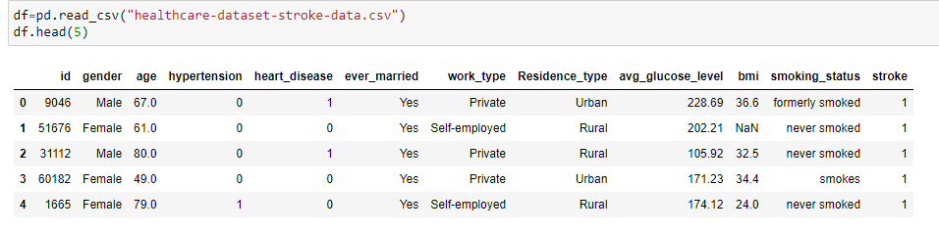
Data Set
Stroke Prediction Dataset
Source: www.kaggle.com
- 5110 rows × 12 columns

Slide 3
Libraries Used
Import pandas as pd
Import numpy as np
Import matplotlib.pyplot as plt
Import seaborn as sns

Slide 4
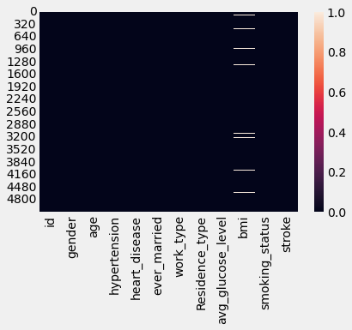
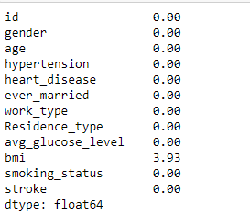
Data Cleaning
sns.heatmap(df.isnull().sum())
Percentage of value is missing in the dataset:
round(df.isnull().mean()*100,2)
Fill the missing value in the bmi columns by the mean:
df.fillna(df["bmi"].mean(),inplace=True)

Slide 5
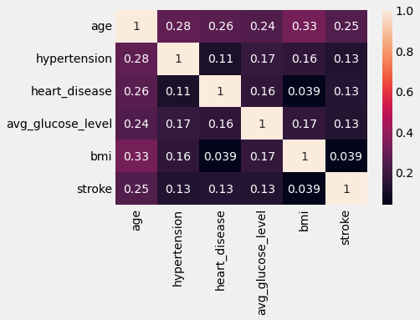
Correlation Matrix:
cor=df.corr()
sns.heatmap(cor,annot=True)
The most affecting features of predicting strokes are age, hypertension, heart disease, and avg_glucose_level.

Slide 6
Finding Outliers in the numerical columns and perform capping:
sns.boxplot(df["age"])
sns.boxplot(df["avg_glucose_level"])
sns.boxplot(df["bmi"])
Perform the capping in the avg_glucose_level and bmi columns to remove the outliers.
upper_limit=170
df["avg_glucose_level"]=np.where(df["avg_glucose_level"]>upper_limit,upper_limit,df["avg_glucose_level"])
upper_limit=46
df["bmi"]=np.where(df["bmi"]>upper_limit,upper_limit,df["bmi"])

Slide 7
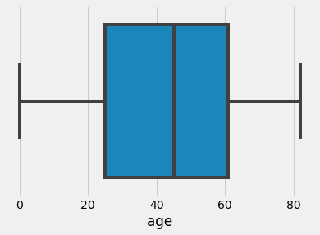
Box plot
The box plot of the age columns shows there are no outliers in the age columns.

Slide 8
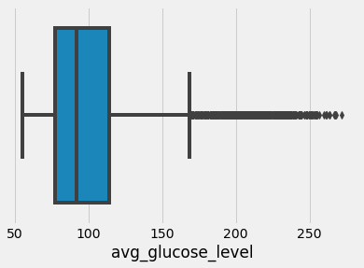
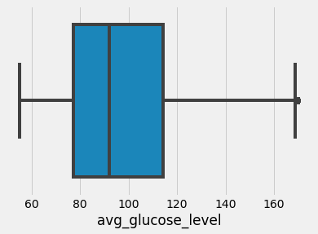
Box plot
The figure shows the box plot of columns avg_glucose_level before and after the capping.

Slide 9
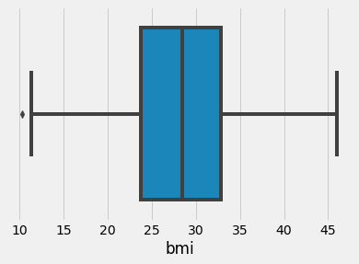
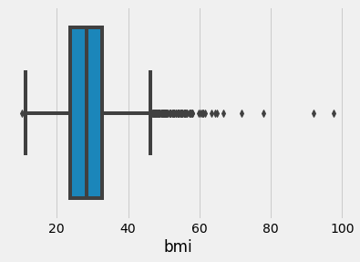
Box plot
The figure shows the box plot of columns bmi before and after the capping.

Slide 10
EDA by different columns:
sns.distplot(df["age"])
sns.catplot(x="gender",y="stroke",hue="Residence_type",kind="bar",data=df)
sns.catplot(x="gender",y="stroke",hue="ever_married",kind="bar",data=df)
plt.figure(figsize=(10,10))
sns.catplot(x="smoking_status",y="stroke",kind="bar",data=df)
plt.xticks(rotation=45)
plt.show()

Slide 11
Drop some columns and Split Dataset
Drop the gender, Residence_type, ever_married columns, id, and work_type columns.
df.drop(columns=[“id“,”work_type],inplace=True)
df.drop(columns=["gender","Residence_type","ever_married"],inplace=True)
Splitting a dataset for the training and testing:
from sklearn.model_selection import train_test_split
x=df.iloc[:,:6]
y=df[["stroke"]]
x_train,x_test,y_train,y_test=train_test_split(x,y,test_size=0.3)

Slide 12
Apply Ordinal Encoder
Apply Ordinal Encoder on the smoking_status columns.
from sklearn.preprocessing import OrdinalEncoder
oe=OrdinalEncoder(categories=[["never smoked","formerly smoked","smokes","Unknown"]])
x_train["smoking_status"]=oe.fit_transform(x_train.loc[:,["smoking_status"]])
x_test["smoking_status"]=oe.transform(x_test.loc[:,["smoking_status"]])

Slide 13
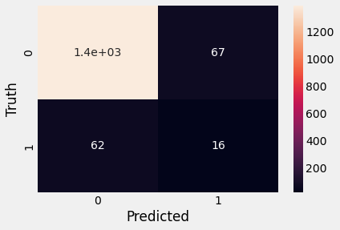
Apply Decision Tree Algorithm
from sklearn.tree import DecisionTreeClassifier
model=DecisionTreeClassifier()
model.fit(x_train,y_train)
y_pred=model.predict(x_test)
model.score(x_test,y_test)
from sklearn.metrics import confusion_matrix
cm=confusion_matrix(y_test,y_pred)
sns.heatmap(cm,annot=True)
plt.xlabel("Predicted")
plt.ylabel("Truth")

Slide 14
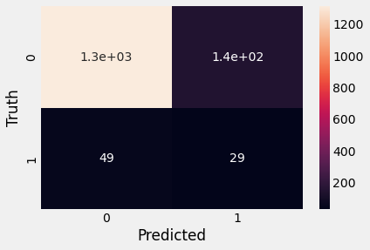
Apply Naïve Bayes Algorithm
from sklearn.naive_bayes import GaussianNB
model1=GaussianNB()
model1.fit(x_train,y_train)
model1.score(x_test,y_test)
y_pred1=model1.predict(x_test)
from sklearn.metrics import confusion_matrix
cm=confusion_matrix(y_test,y_pred1)
sns.heatmap(cm,annot=True)
plt.xlabel("Predicted")
plt.ylabel("Truth")

Slide 15
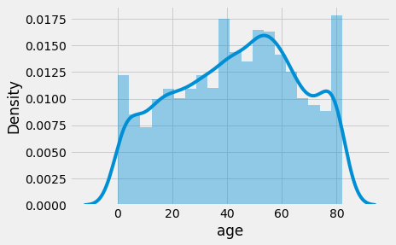
Data Visualization
A person which has of medium or high age is more chance of stroke.

Slide 16
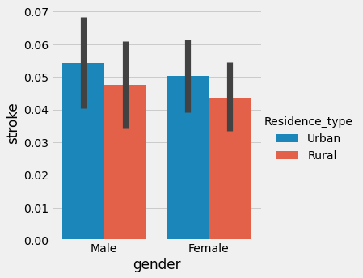
Data Visualization (Cont…)
The graph shows the chance of strokes by gender wise along with the residence type.

Slide 17
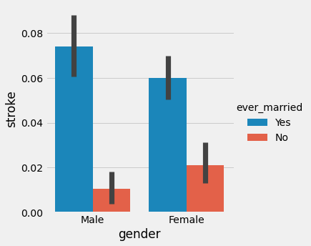
Data Visualization (Cont…)
The graph shows the chance of stroke in males and females by considering whether they are married or not.

Slide 18
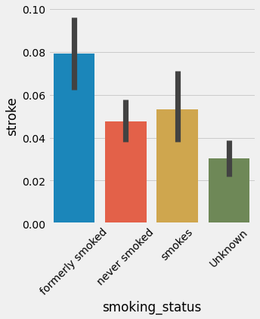
Data Visualization (Cont…)
The graph shows the chance of strokes whether they take a smoke or not.

Slide 19
Thank You

